Slide 1
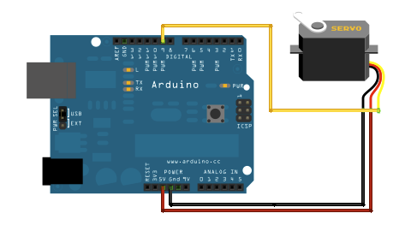
Servo motors
A DC motor with a control circuit
Servo motors are controlled by PWM through the control pin

Slide 2
FOR LOOP
For loop run a series of commands a number of times in a program.
for (declaration & definition ; condition ; increment)
{
// statements
}
for (int i = 0 ; i < 10 ; i++)
{
println(i);
}

